Slide 1
Course Code: CSC211A Course Title: Formal Languages and Automata Theory
Session 26: Applications of Regular Closure-2
Course Leader:
Prakash P
prakashp.cs.et@msruas.ac.in

Slide 2
Session Objectives
At the end of this session, student will be able
Explain the pumping lemma
Understand pumping lemma for CFL
Prove whether the given language is context free or not

Slide 3
Session Topics
Pumping lemma
Pumping lemma for CFL
Prove whether the given language is context free or not

Slide 4
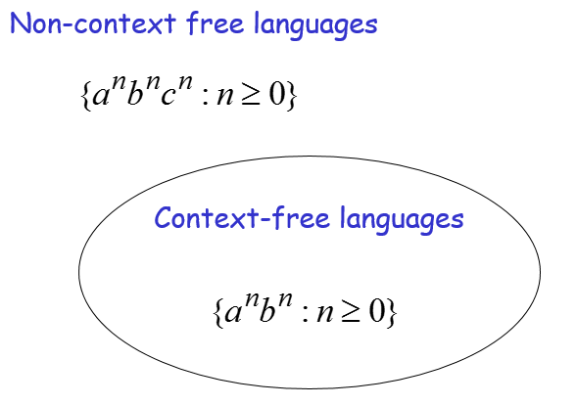
Pumping Lemma

Slide 5
Pumping Lemma for CFL
Theorem:
The language
is not context free
Proof:
Use the Pumping Lemma for context-free languages

Slide 6
Pumping Lemma for CFL
Assume for contradiction that
is context-free
Since is context-free and infinite we can apply the pumping lemma

Slide 7
Pumping Lemma for CFL
Pumping Lemma gives a magic number
such that:
Pick any string with length
We pick:

Slide 8
Pumping Lemma for CFL
We can write:
with lengths and

Slide 9
Pumping Lemma for CFL
Pumping Lemma says:
for all

Slide 10
Pumping Lemma for CFL
We examine all the possible locations of string in

Slide 11
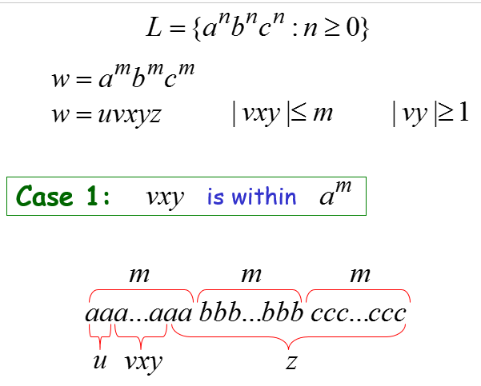
Pumping Lemma for CFL

Slide 12
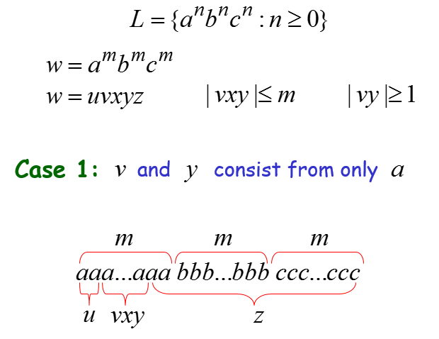
Pumping Lemma for CFL

Slide 13
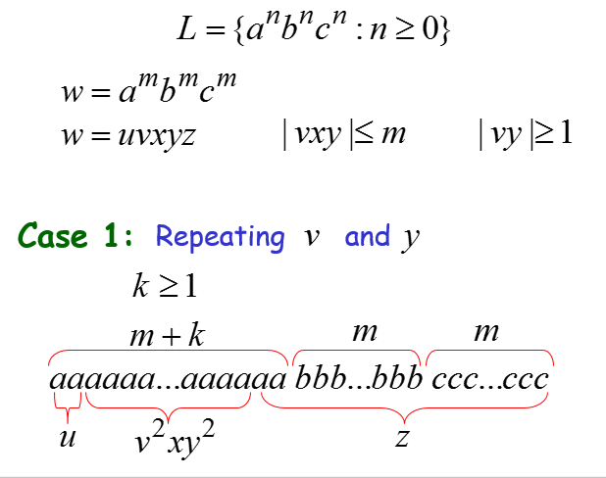
Pumping Lemma for CFL

Slide 14
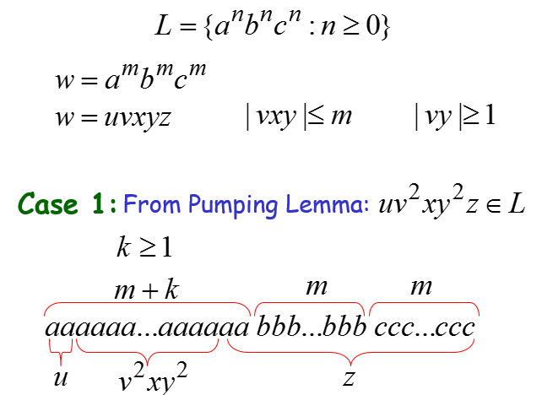
Pumping Lemma for CFL

Slide 15
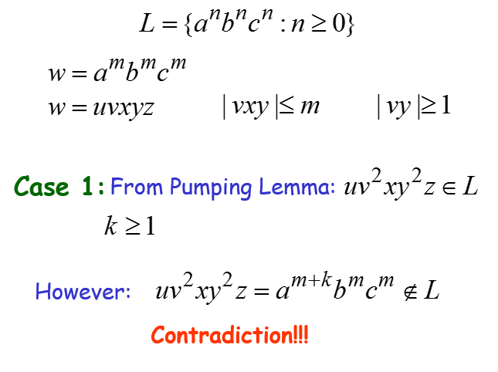
Pumping Lemma for CFL

Slide 16
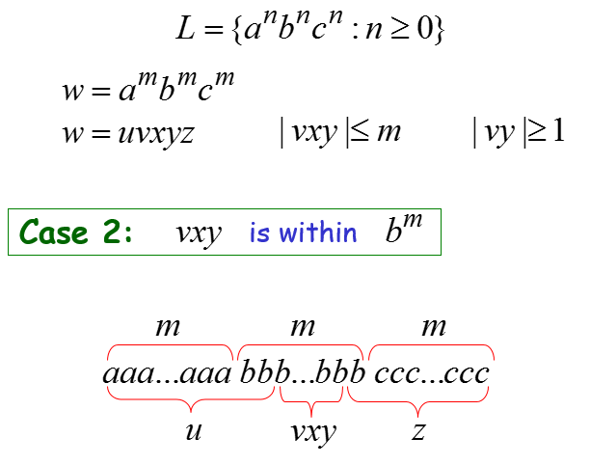
Pumping Lemma for CFL

Slide 17
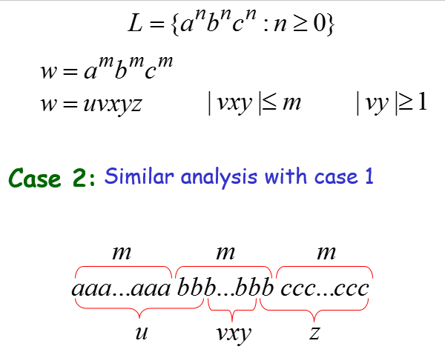
Pumping Lemma for CFL

Slide 18
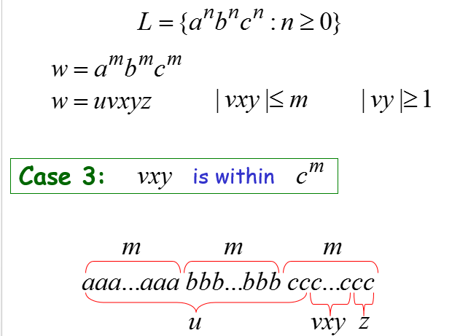
Pumping Lemma for CFL

Slide 19
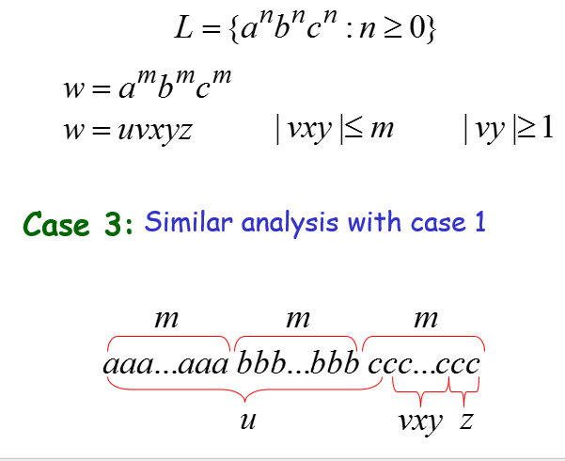
Pumping Lemma for CFL

Slide 20
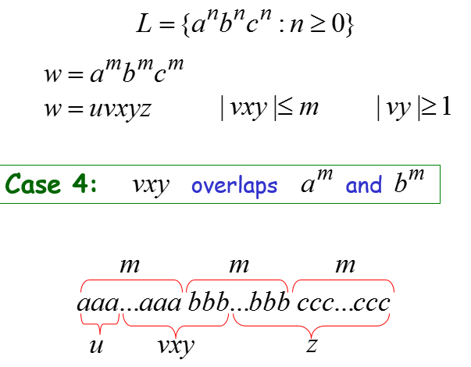
Pumping Lemma for CFL

Slide 21
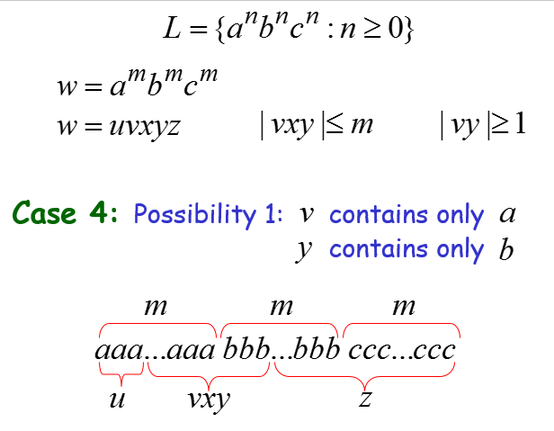
Pumping Lemma for CFL

Slide 22
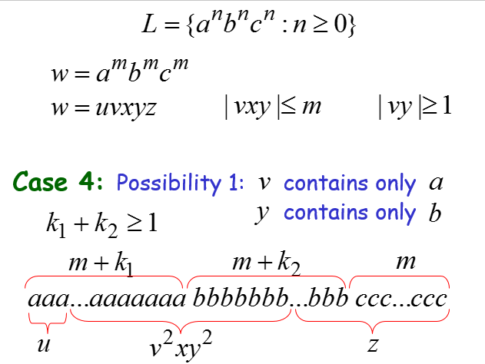
Pumping Lemma for CFL

Slide 23
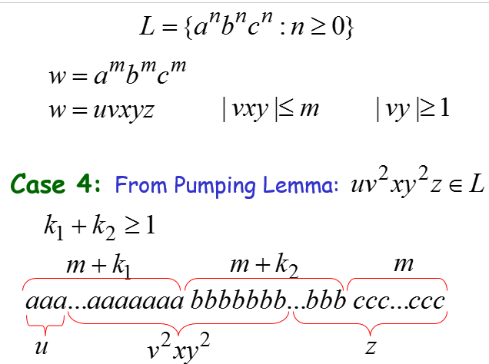
Pumping Lemma for CFL

Slide 24
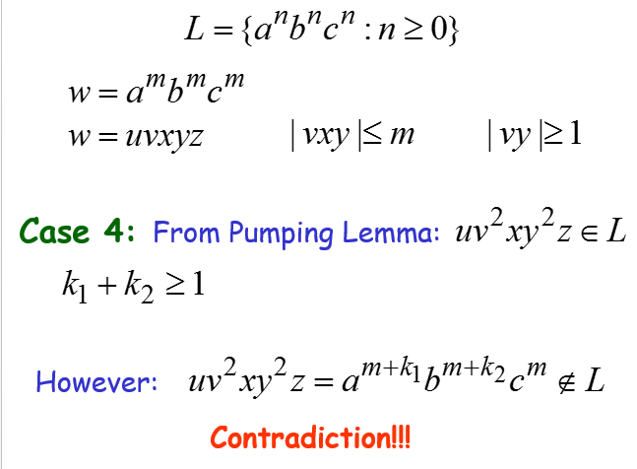
Pumping Lemma for CFL

Slide 25
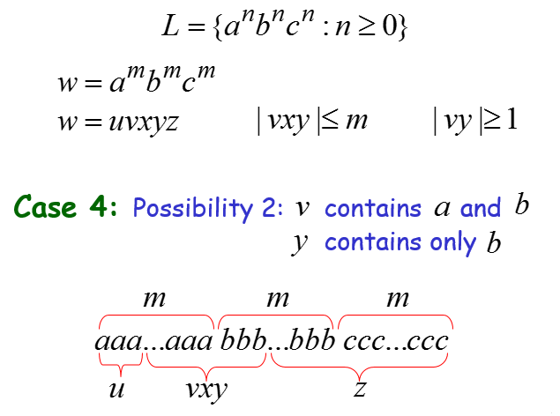
Pumping Lemma for CFL

Slide 26
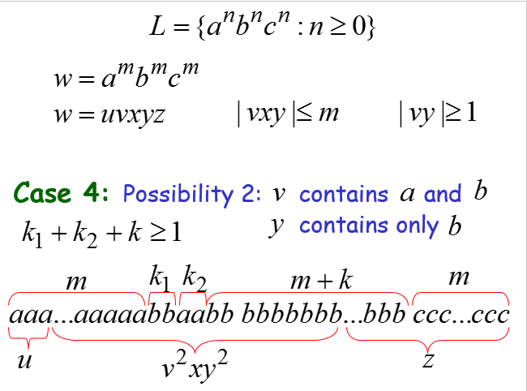
Pumping Lemma for CFL

Slide 27
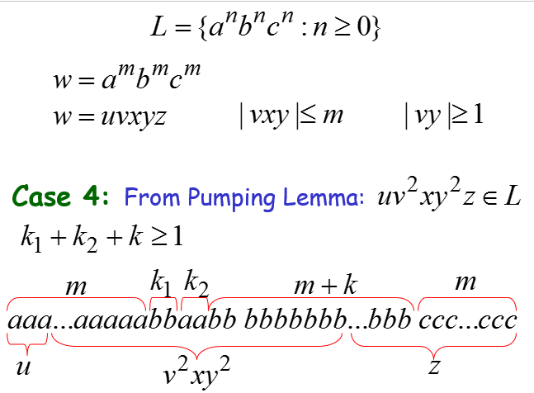
Pumping Lemma for CFL

Slide 28
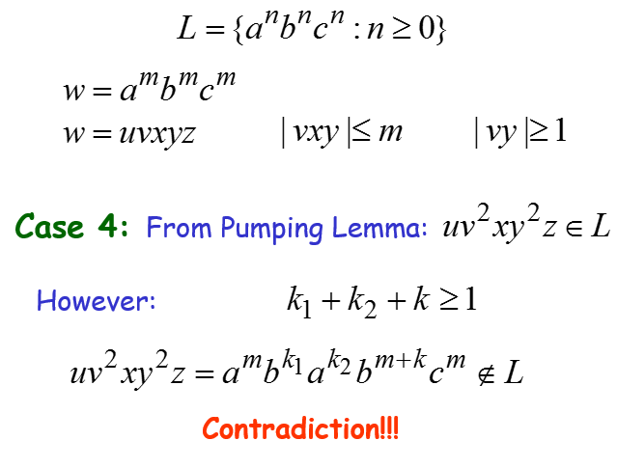
Pumping Lemma for CFL

Slide 29
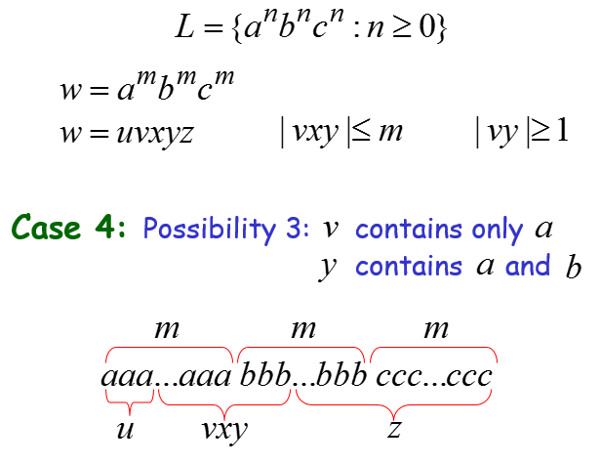
Pumping Lemma for CFL

Slide 30
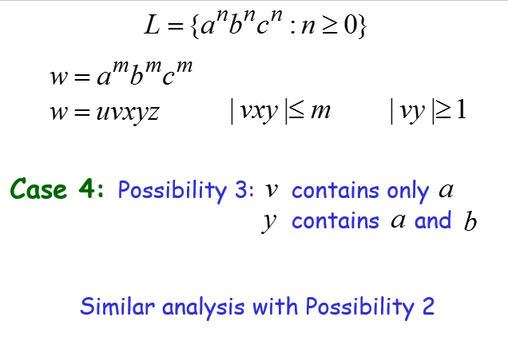
Pumping Lemma for CFL

Slide 31
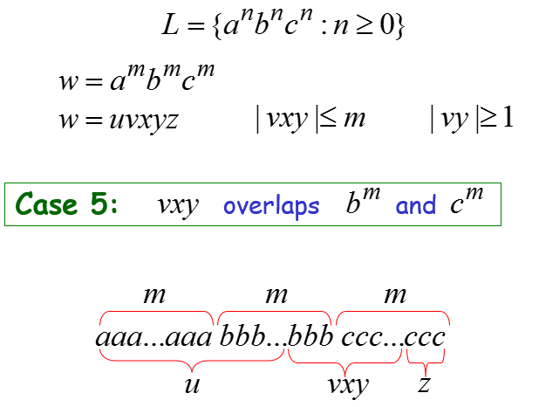
Pumping Lemma for CFL

Slide 32
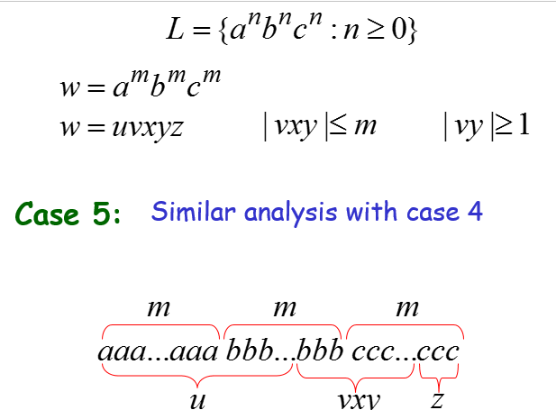
Pumping Lemma for CFL

Slide 33
Pumping Lemma for CFL
There are no other cases to consider
(since , string cannot
overlap , and at the same time)

Slide 34
Pumping Lemma for CFL
In all cases we obtained a contradiction
Therefore:
The original assumption that
is context-free must be wrong
Conclusion:
is not context-free

Slide 35
Summary
Pumping lemma is used to prove whether the language is context free or not

